Slide 1
Fundamental Rights and Freedoms
Key Stage 3

Slide 2
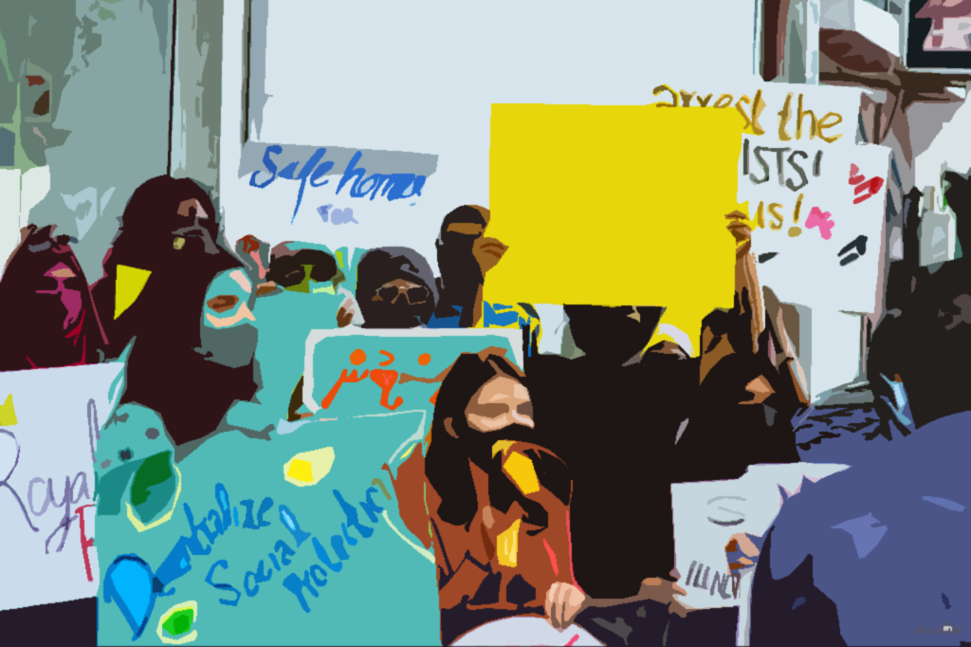
Notes:
A ‘right’ is a moral or a legal entitlement to have a do something
Human rights are for people living only in Maldives.
People have the right to say whatever they want.
All people have equal rights.
Do children have their own special rights, as well as other human rights?

Slide 3
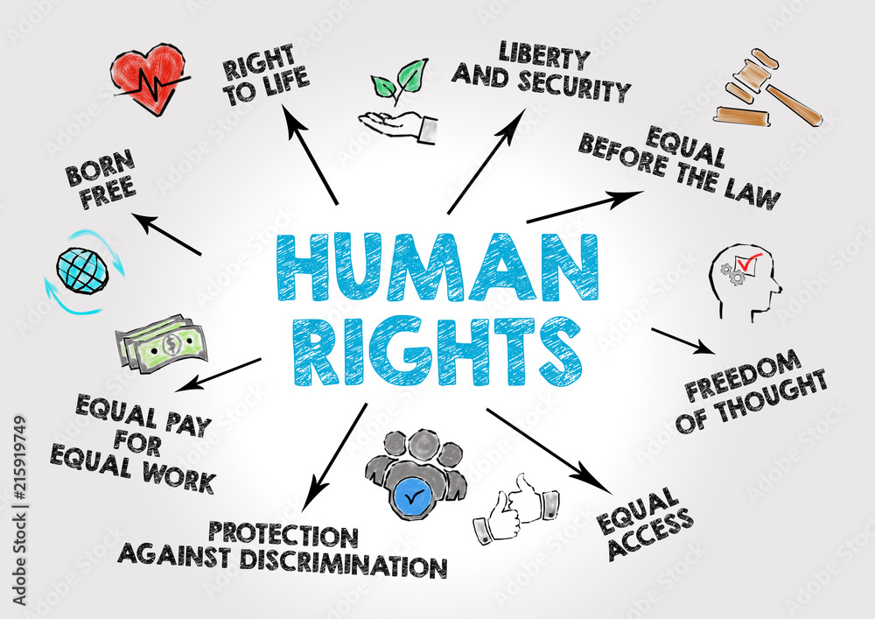
Definition:
Rights
“Rights are fundamental entitlements or privileges that individuals possess by virtue of being human.”

Slide 4
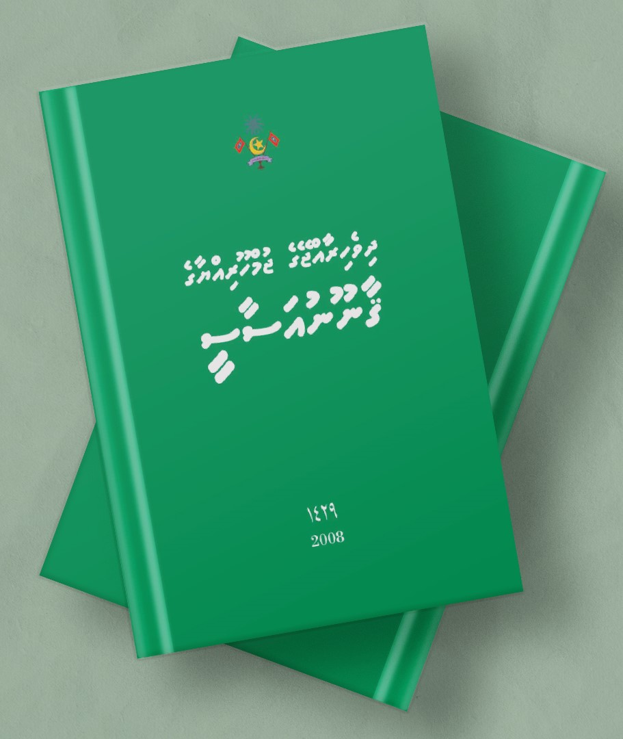
Fundamental Rights and Freedoms
The Constitution of Maldives enumerates the essential rights and freedoms for every Citizen.
The Constitution guarantees rights and freedoms that are not contrary to the tenets of Islam.
Notes:
Fundamental rights and freedom are necessary for a nation for the growth of every individual and also for safeguarding peoples’ interests. They are crucial for the government in the sense that they serve as the nation’s backbone. In difficult times, citizens can be protected by their rights.

Slide 5
Chapter 2, Article 67:
The exercise and enjoyment of fundamental rights and freedoms is inseparable from the performance of responsibilities and duties
State
Citizen
RIGHTS
RESPONSIBILITIES
Notes:
Brainstorm the student about rights and responsibilities
The entitlements and duties as citizens.
Rights are freedoms that are protected legally.
Responsibilities are things you should do.
Unlike the USA, Maldives, does not have a national Bill of Rights that officially protects our rights

Slide 6

Rights vs. Responsibilities
The rights of Citizens empower them to actively participate in democratic processes, while their responsibilities involve contributing positively to their communities and adhering to ethical and legal standards.
Notes:
As stated in the Constitution, the exercise and enjoyment of fundamental rights and freedoms is inseparable from the performance of responsibilities and duties.
The combination of rights and responsibilities forms the foundation for an engaged and responsible citizenship.

Slide 7
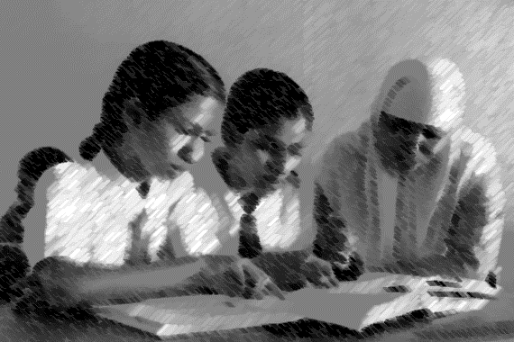
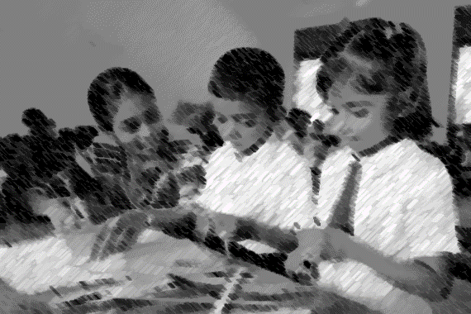
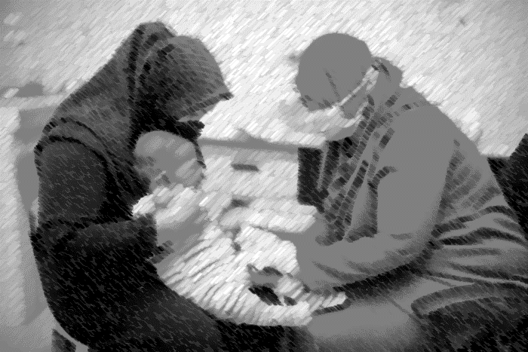

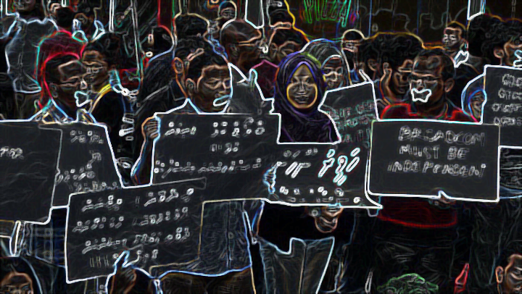
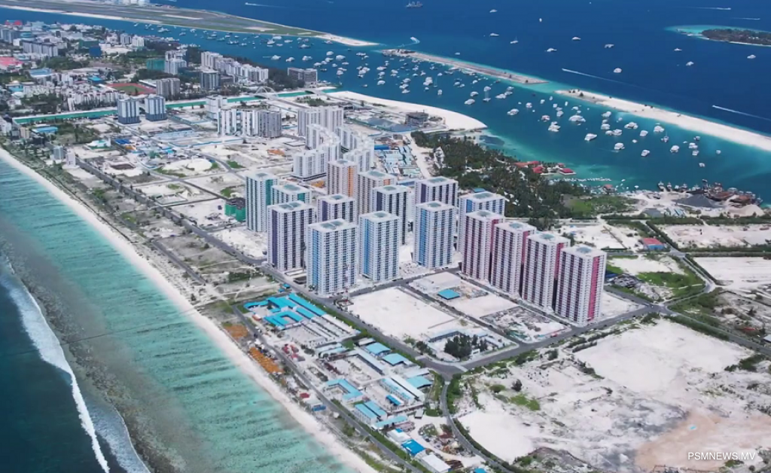

Slide 8
Major conventions signed and ratified by our country:
The Convention on the Elimination of all forms of Racial Discrimination (ICERD)
The International Covenant on Civil and Political Rights (ICCPR)
The International Covenant on Economics, Social and Cultural Rights (ICESCR)
The Convention on the Elimination of all forms of Discrimination against Women (CEDAW)

Slide 9
Major conventions signed and ratified by our country:
The Convention against Torture and other Cruel, Inhumane or Degrading Treatment or Punishment (CAT)
The Convention on the rights of the Child (CRC)
The Convention on the rights of Persons with Disabilities CRPD)

Slide 10
Convention
On the
Rights of the Child
(CRC)
4 Basic Principles
1
non-discrimination
2
4
Core Principles
Core Principles
Meaningfully engaging and respecting children's views.
Right to life, survival, and development
3
Best interest of the child
Notes:
Individual Rights and Freedoms:
Freedom from restraint - One is free to engage in any conduct or activity that is not expressly prohibited by Islamic Shari’ah or by law.
Equality - Everyone is equal before and under the law and has the right to equal protection and equal benefit of the law.
Privacy - Everyone has the right to respect their private and family life.
Freedom of expression - Everyone has the right to freedom of thought and the freedom to communicate opinions and expression in a manner that is not contrary to any tenet of Islam.
Right to life - Everyone has the right to life, liberty and security.
Social and Economic Rights
Economic and social rights - Everyone has the right to nutritious food and clean water, clothing and housing, better health care, a healthy and ecologically balanced environment, equal access to means of communication, the establishment of an adequate sewage system, and the establishment of electricity.
Freedom from acquiring and imparting knowledge - Everyone has the right and freedom to acquire and impart knowledge, information and learning.
Special protection to children, young, elderly, and disadvantaged people - Children and young people, elderly and disadvantaged people are entitled to special protection and special assistance from the family, the community and the State.
Civil and political rights
Right to vote - Every individual above eighteen years of age, has the right to vote in elections, and in public referendums.
Freedom of Assembly and Association: The right to gather and associate with others for peaceful purposes.

Slide 11


Article 17 of the Maldivian Constitution:
Everyone is entitled to the rights and freedoms included in this chapter without discrimination of any kind, including race, national origin, colour, sex, age, mental or physical disability, political or other opinion, property, birth or other status, or native island.
Notes:
Fundamental rights and freedom are necessary for a nation for the growth of every individual and also for safeguarding peoples’ interests. They are crucial for the government in the sense that they serve as the nation’s backbone. In difficult times, citizens can be protected by their rights.

Slide 12
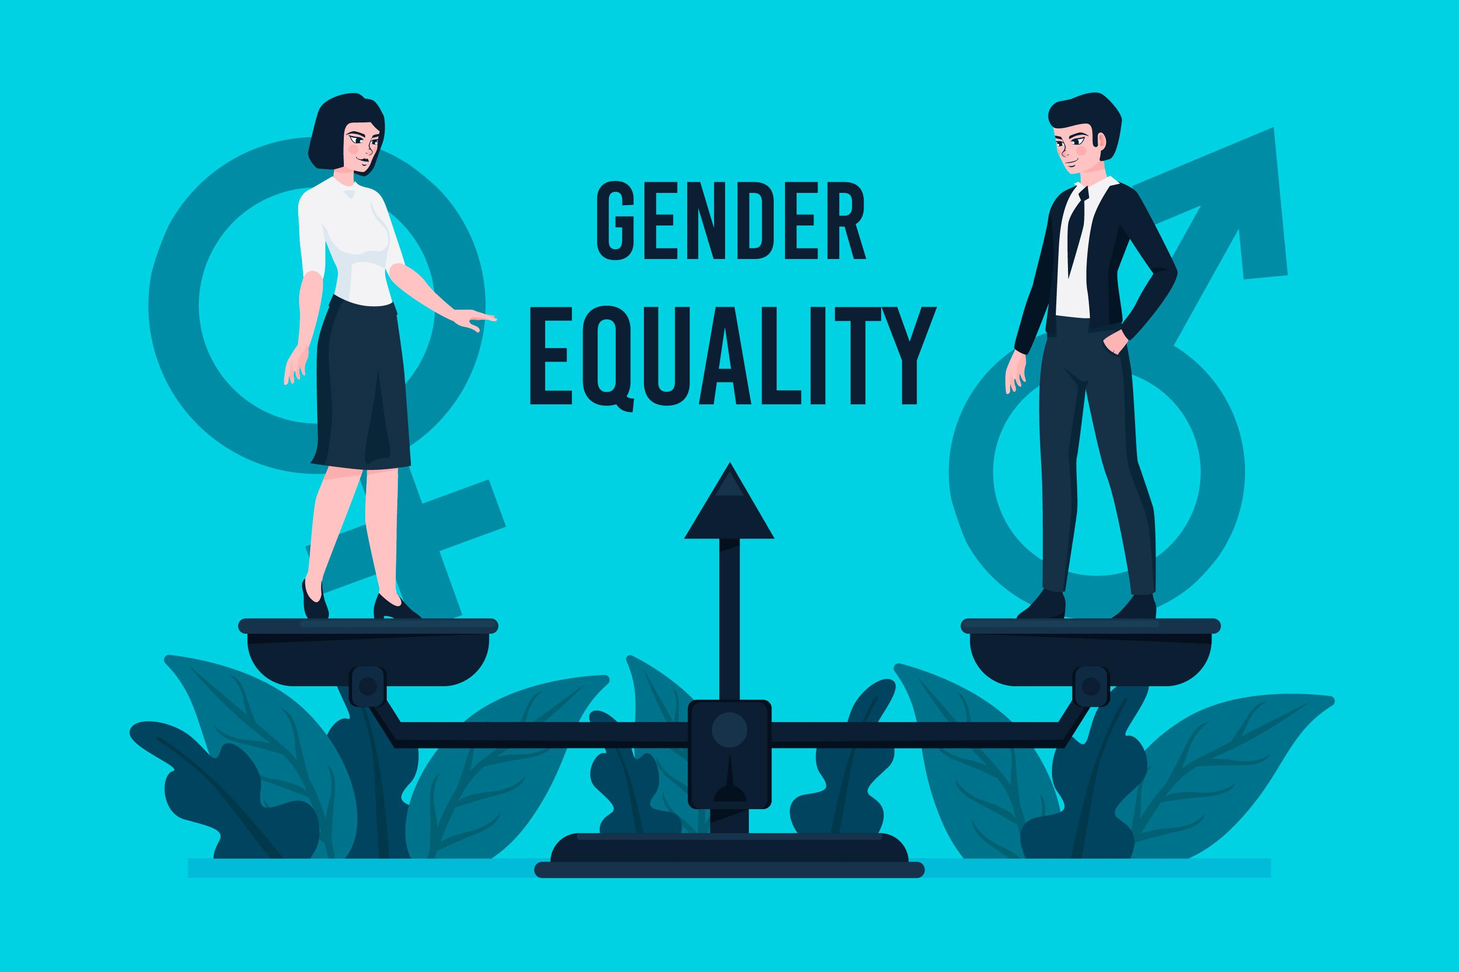



Gender Equality bill:
Comprises of 46 articles which calls for equal opportunities in employment, including salary.
Goal: to guarantee that every person, regardless of gender, is granted the rights provided by the nation's laws and Constitution.
The bill also states that the media needs to promote gender equality.

Slide 13



Activity
Some examples of Important rights and freedoms…
  Everyone has the right to education.
Everyone has the right to freedom of opinion and expression.
Everyone has the right to a decent standard of living.

Slide 14

Activity
In groups, create a mind map to present
everything they can think of regarding one
of those fundamental rights.
Use the following questions to guide your
ideas:
What does it mean to you to have this right? What are other things connected to this right?
What Government offices/institutions are responsible to ensure this right?
What are your responsibilities that come with this right?

